Slide 1
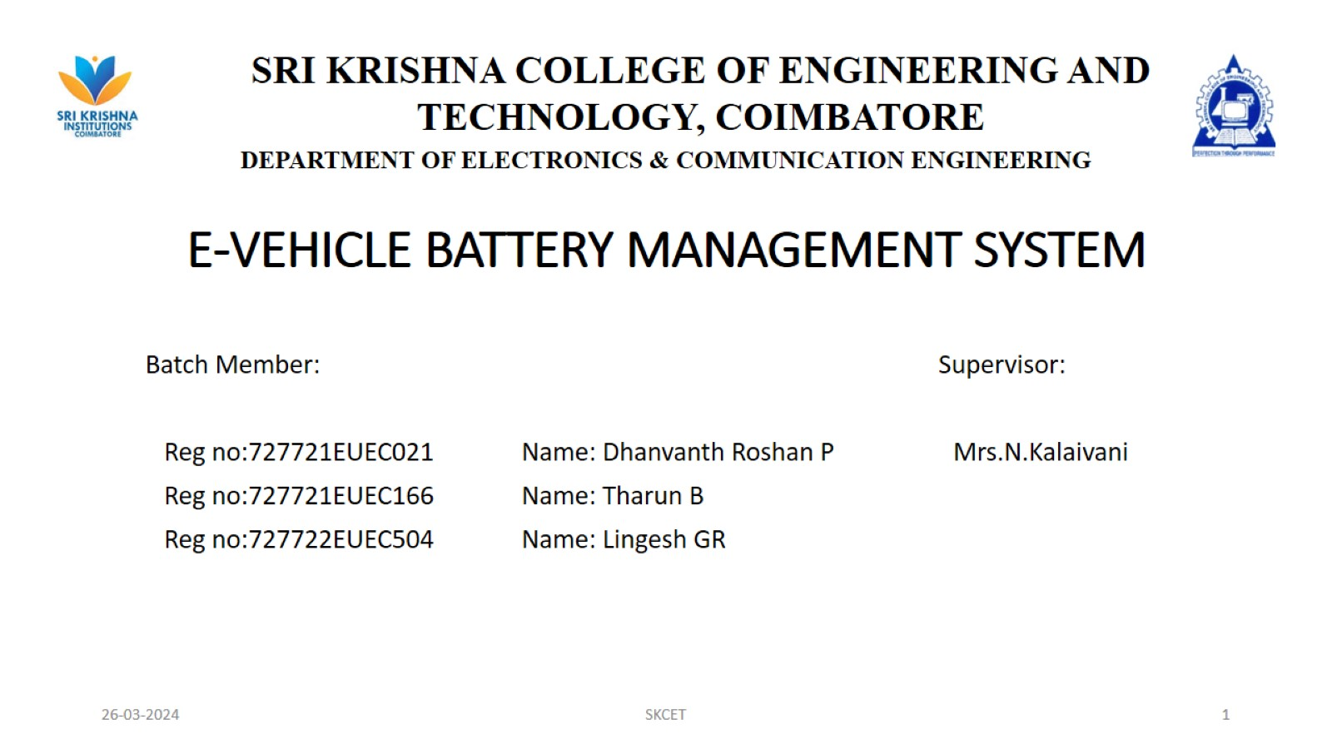
E-VEHICLE BATTERY MANAGEMENT SYSTEM

Slide 2
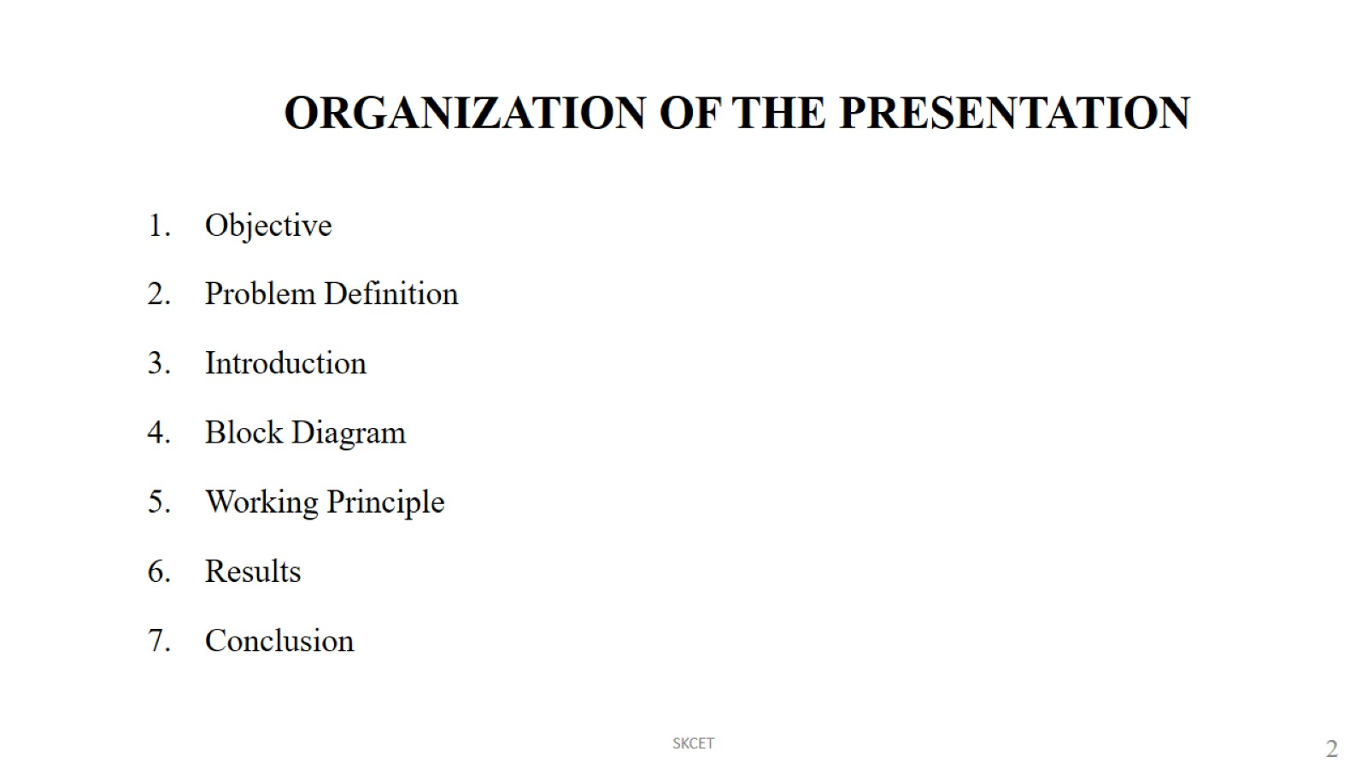
ORGANIZATION OF THE PRESENTATION

Slide 3
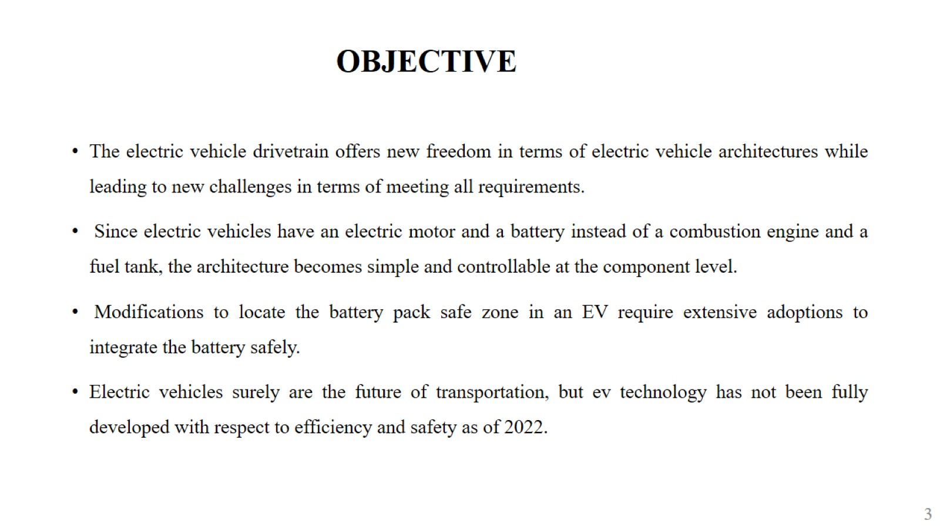
OBJECTIVE

Slide 4
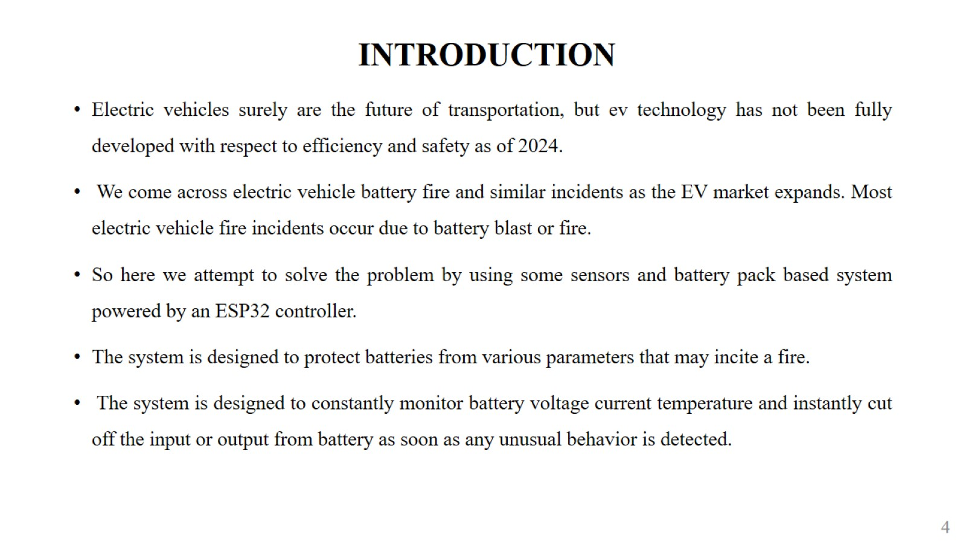
INTRODUCTION

Slide 5
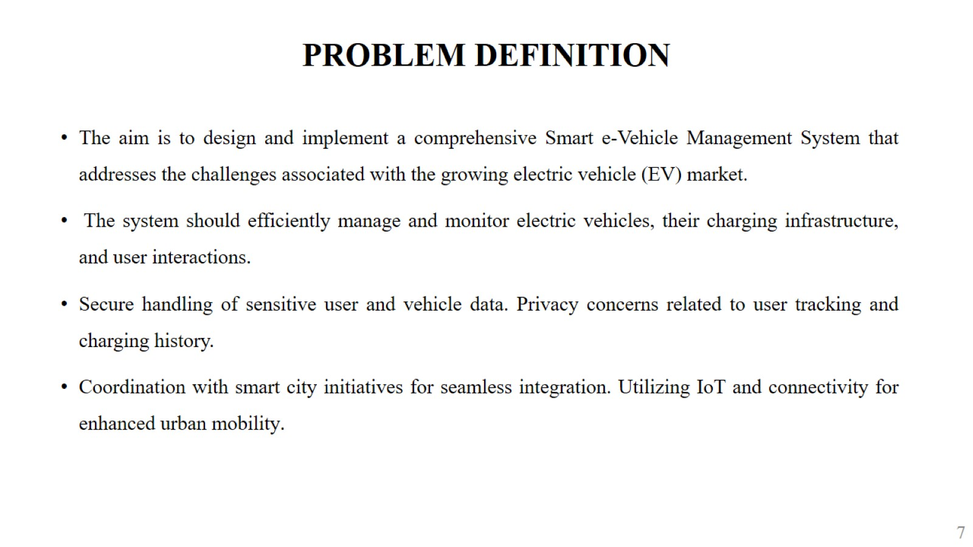
PROBLEM DEFINITION

Slide 6
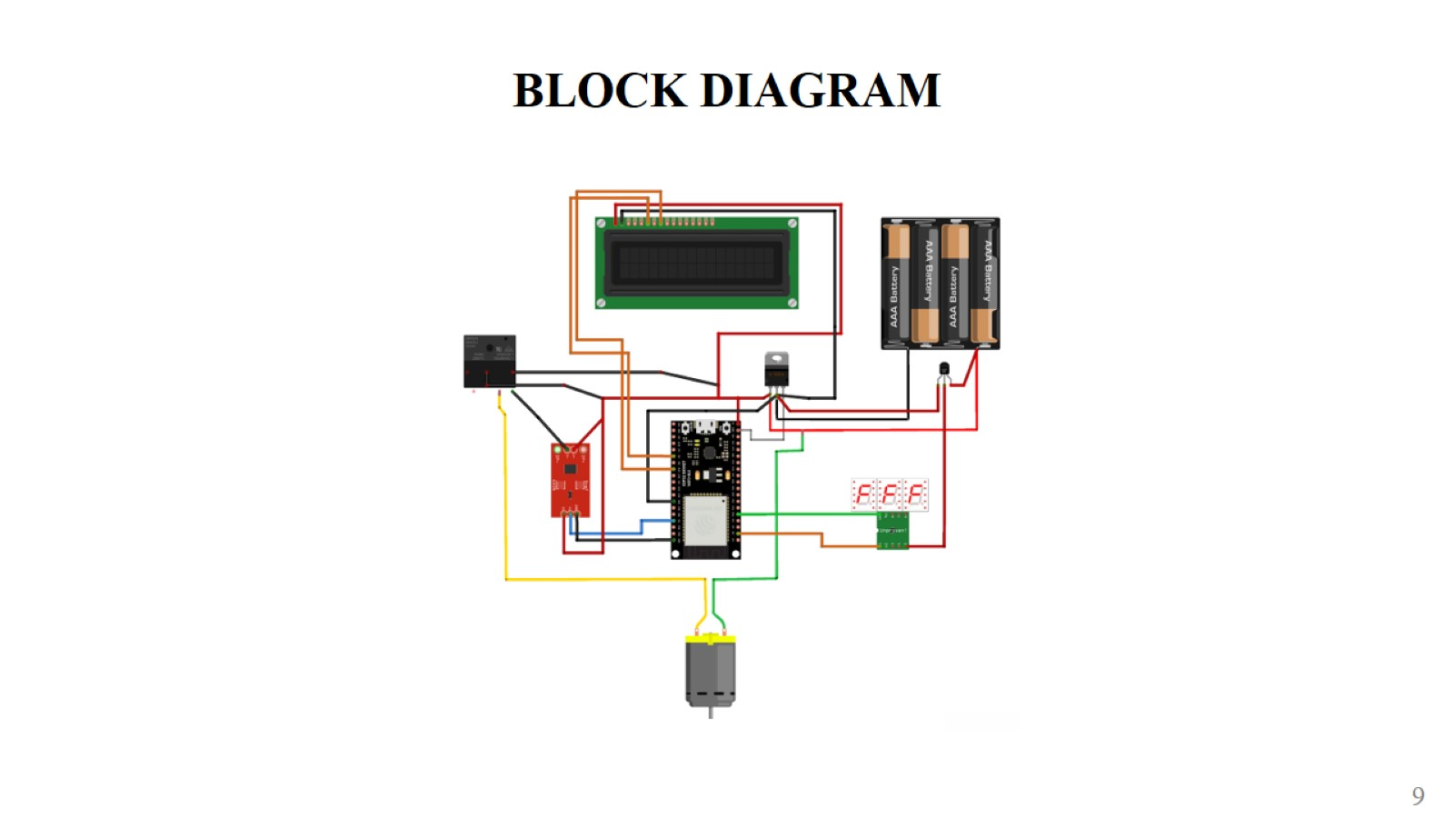
BLOCK DIAGRAM

Slide 7
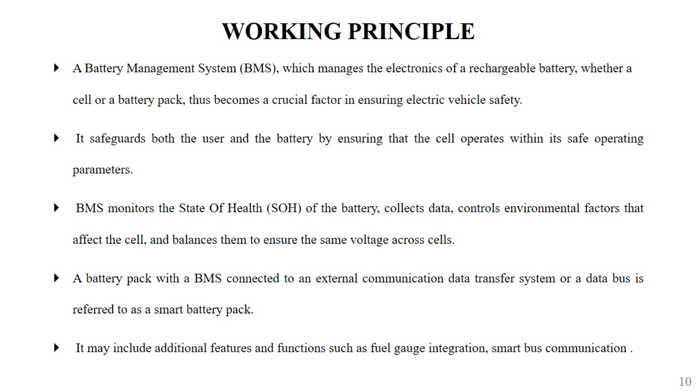
WORKING PRINCIPLE

Slide 8
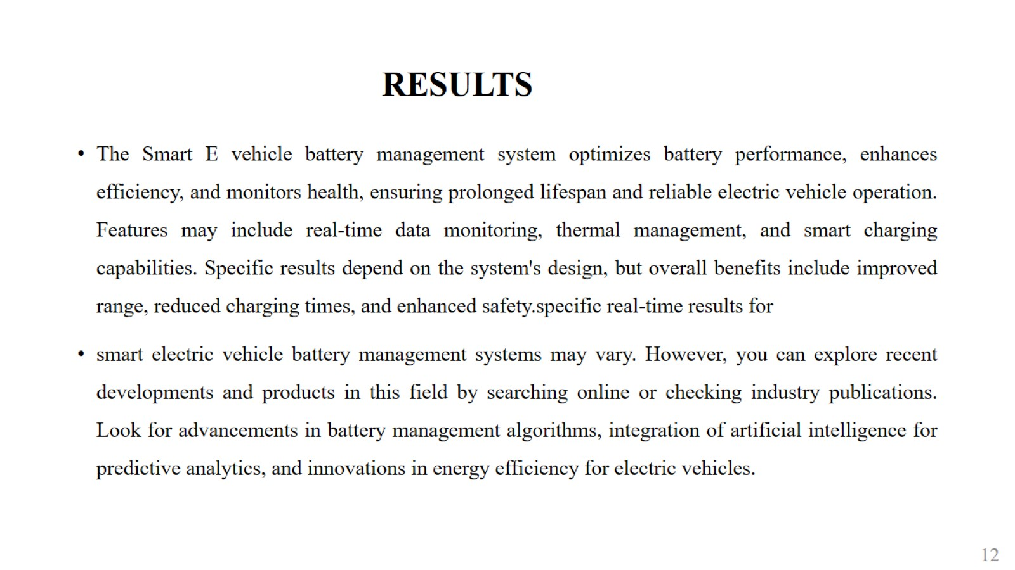
RESULTS

Slide 9
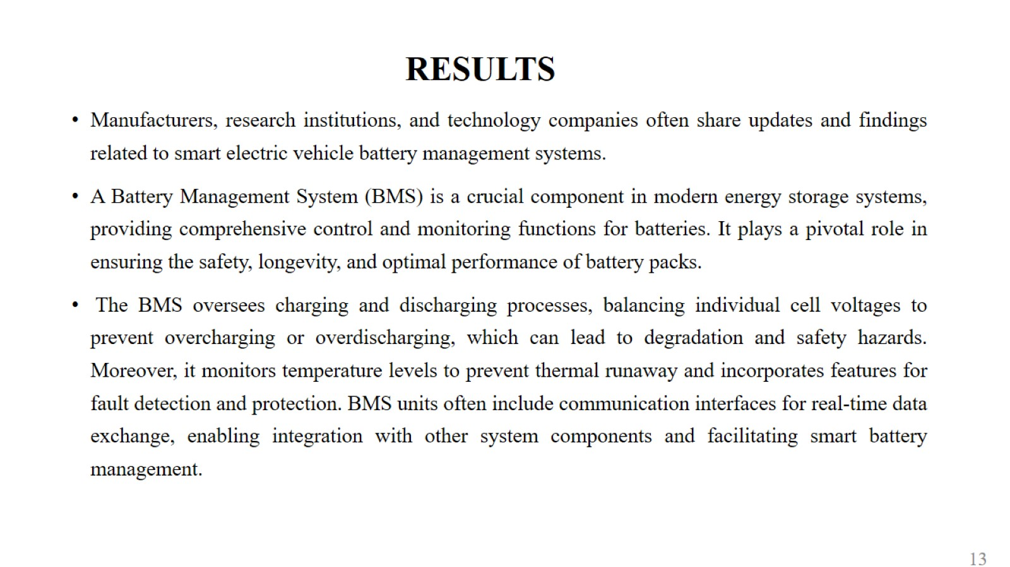
RESULTS

Slide 10
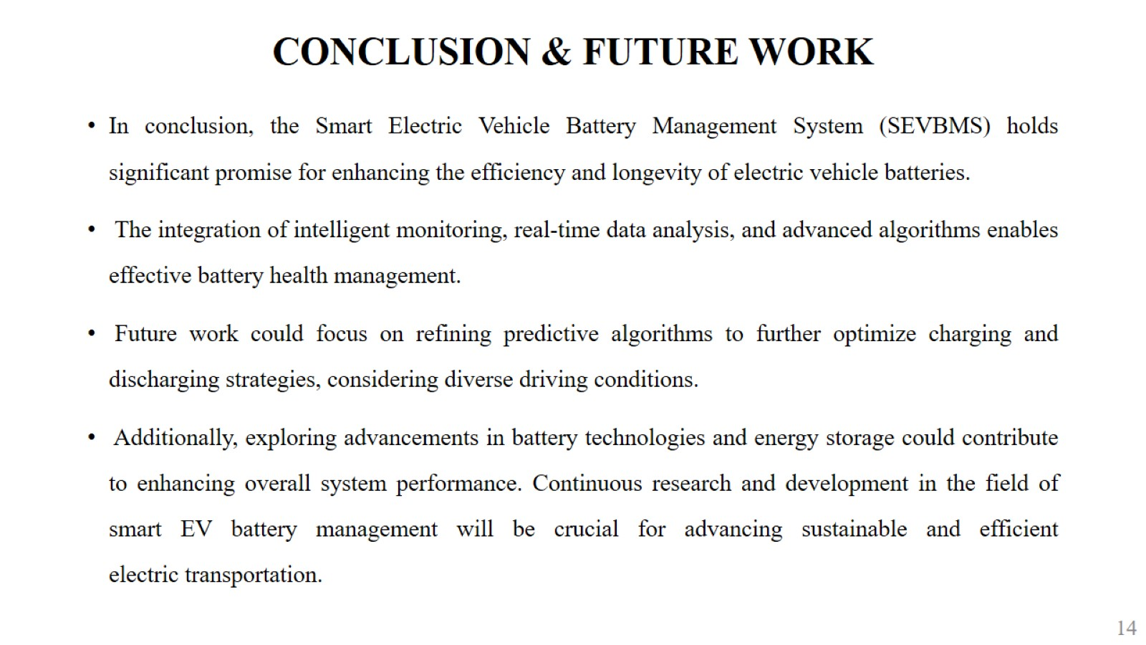
CONCLUSION & FUTURE WORK

Slide 11

THANK YOU

